Slide 1

Tech Stock Prediction
Marlene Aviles
630: Predictive Analytics
Final Course Project

Slide 2
BACKGROUND
STOCK MARKET SERVES AS AN INDICATOR OF ECONOMY STATUS
STANDARD & POOR’S 500 INDEX BASED ON 500 LARGEST COMPANIES
PREDICTING STOCKS ASSISTS INVESTORS IDENTIFY BEST COMPANIES FOR INVESTING
COMPLEX TASK THAT CAN HELP LOSE OR GAIN MONEY
STOCK MARKET CAN BE INTIMIDATING BUT PREDICTIVE ANALYTICS CAN ASSIST

Slide 3
TECH COMPANIES
APPLE - AAPL
AMAZON - AMZN
GOOGLE - GOOG
MICROSOFT - MSFT
S&P 500 INCLUDES TOP TECH COMPANIES
TECH COMPANIES MAKE UP 18% OF S&P 500 MARKET CAP
STATISTICS SUPPORT THAT TECH COMPANIES ARE DESIRABLE
TECH COMPANIES CAN BE SEEN LESS RISKY

Slide 4
COVID-19 EFFECT
START OF 2020 GLOBAL PANDEMIC BEGAN
STOCK MARKET WAS AND IS AFFECTED GIVEN THIS ECOMIC CRISIS
COVID-19 FORCES INDIVIDUALS AND COMPANIES TO BE OUT OF WORK RESULTING IN LESS INVESTMENTS
PREDICTIVE ANALYTICS CAN HELP IDENTIFY IF TECH COMPANIES ARE WORTH INVESTING IN

Slide 5
Project goal
TO CREATE A PREDICTIVE MODEL(S) THAT WILL ASSIST INSTITUTIONAL INVESTORS IDENTIFY WHAT TECH COMPANY IS WORTH INVESTING IN BASED ON PRIOR TRENDS FROM HISTORICAL STOCK DATA
APPLY PREDICTIVE ANALYTIC TECHNIQUES SUCH AS EXPLORATORY DATA ANALYSIS (EDA) AND PREDICTIVE MODELING TO ACHIEVE GOAL

Slide 6
DATA SOURCE
YAHOO FINANCE WEBSITE WAS USED TO EXTRACT STOCK DATA
TWO DATSETS WERE CREATED VIA YAHOO FINANCE WEBSITE
https://finance.yahoo.com/quote/CSV/history

Slide 7
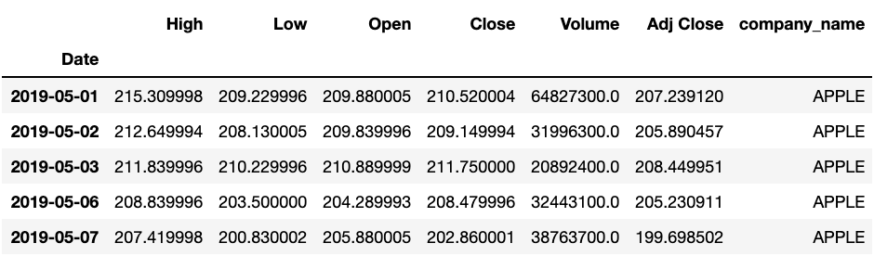
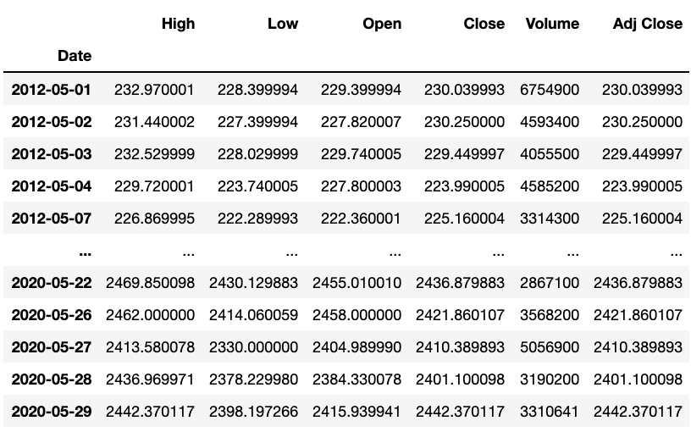
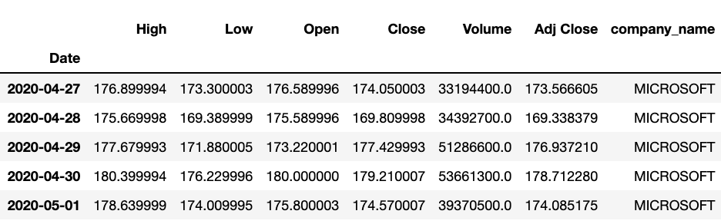
Datasets
BASED ON 4 TECH COMPANIES STOCK DATA FROM 05/01/2019 – 05/01/2020
BASED ON AMAZON STOCK DATA FROM 5/01/2012 – 05/29/2020

Slide 8
Variables
DATE - in format: yy-mm-dd
HIGH - Highest stock price reached in the day
LOW - Lowest stock price reached in the day
OPEN - Stock price when the stock market opened (in USD)
CLOSE - Stock price when the stock market closed (in USD)
VOLUME - Number of shares traded
ADJ CLOSE - Adjusted closing stock price
COMPANY_NAME - Name of the tech company

Slide 9
DATA PREPARATION
DATE RANGES AND TECH COMPANIES HAD TO BE SELECTED
DATA HAD TO BE TRANSFORMED INTO A DATAFRAME
TECH COMPANIES WERE RENAMED
2ND DATASET SCALED USING MINMAXSCALER (0,1) RANGE
2ND DATASET REQUIRED DROPPING THE CLOSE COLUMN FOR PREDICTIVE MODELING

Slide 10
PRELIMINARY ANALYSIS
EDA WAS CONDUCTED TO GAIN A DEEPER UNDERSTANDING OF THE TRENDS AND PATTERNS
EDA EXECUTES VISUALS TO LOOK AT CORRELATIONS, ADJUSTED CLOSING STOCK PRICES, DAILY TRADED VOLUME, AND MOVING AVERAGES

Slide 11
correlations

Slide 12
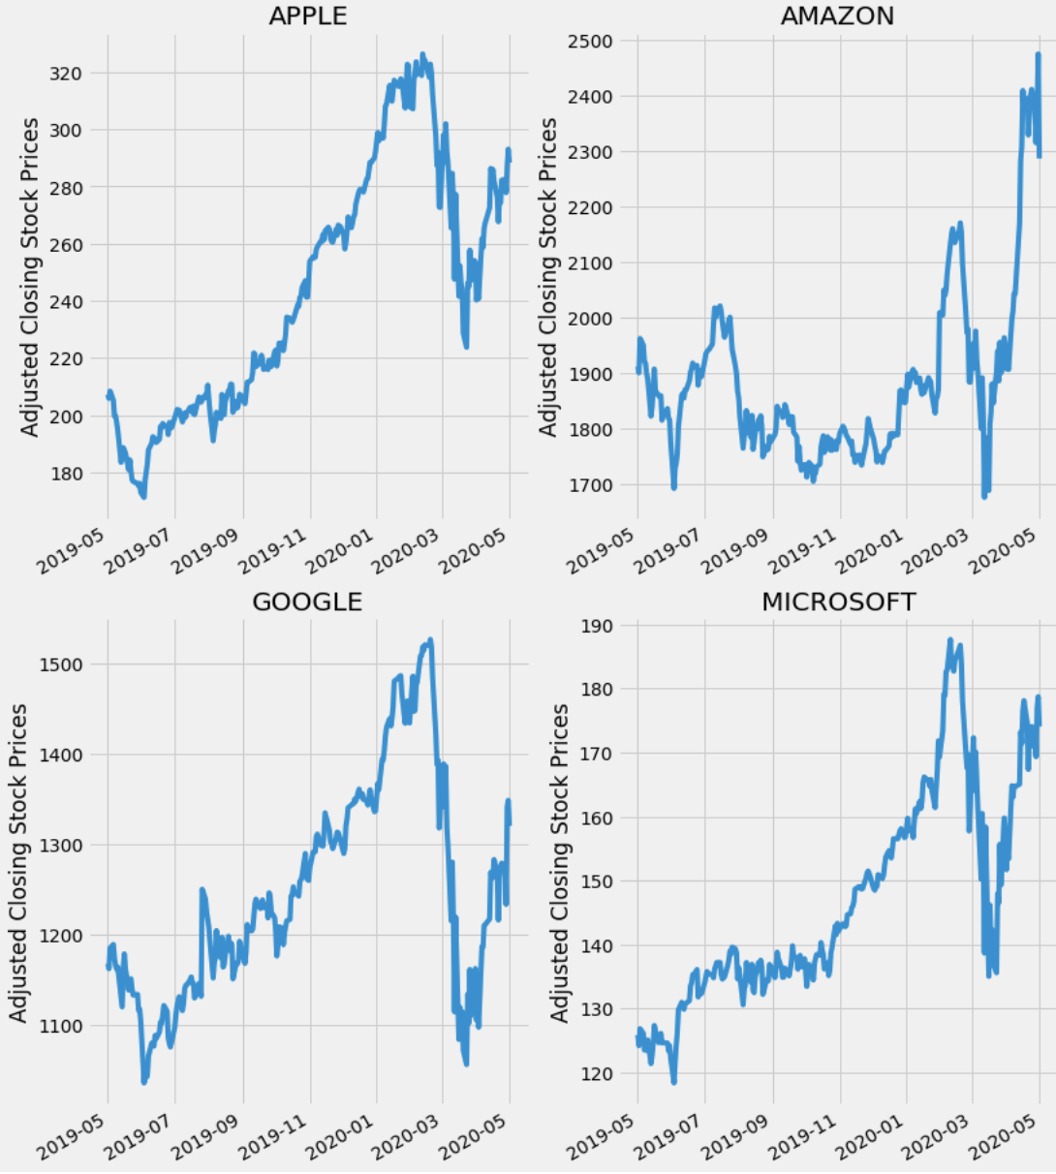
ADJUSTED CLOSING STOCK PRICES

Slide 13
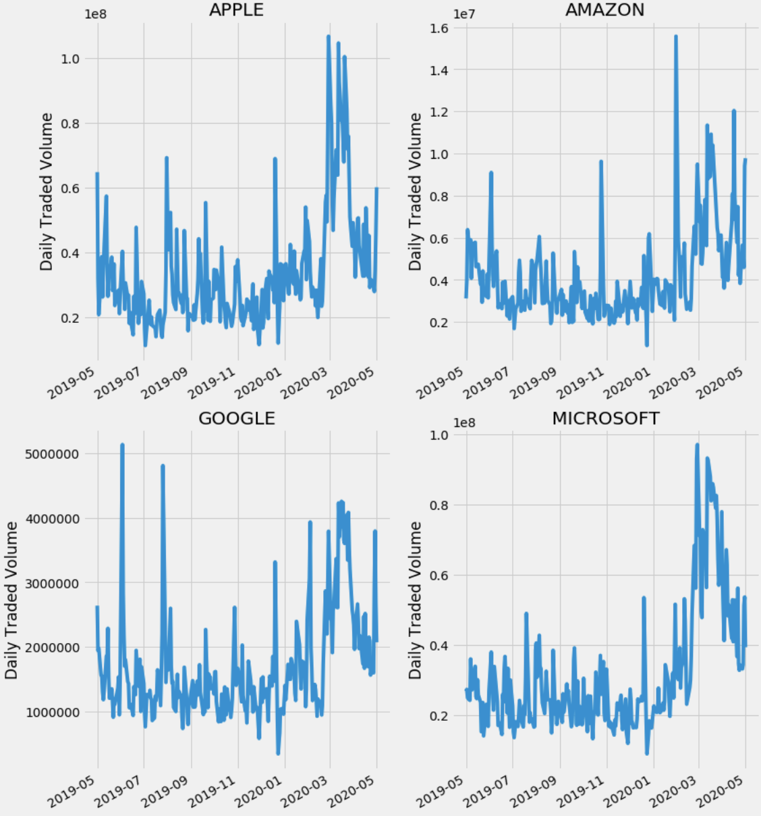
DAILY TRADED VOLUME

Slide 14
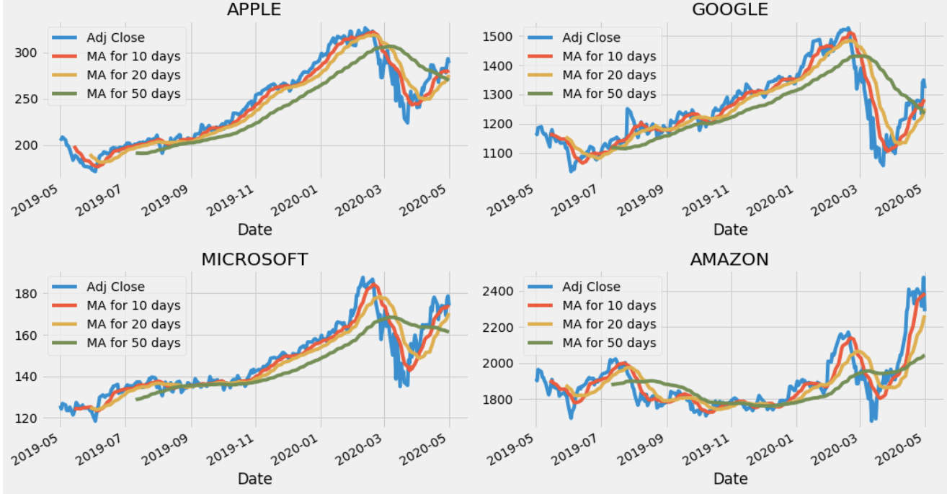
Moving averages

Slide 15
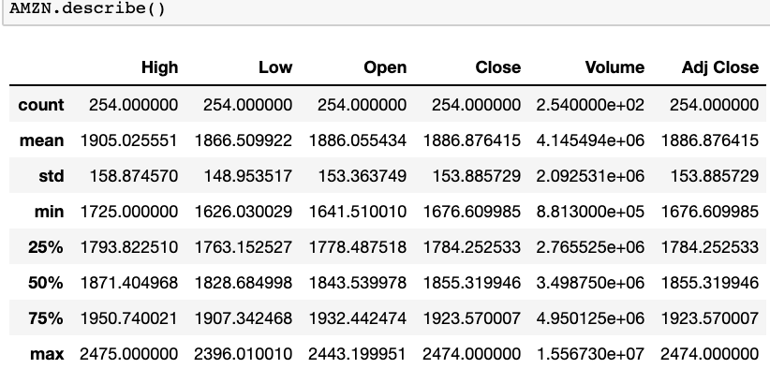

AMAZON selection

Slide 16
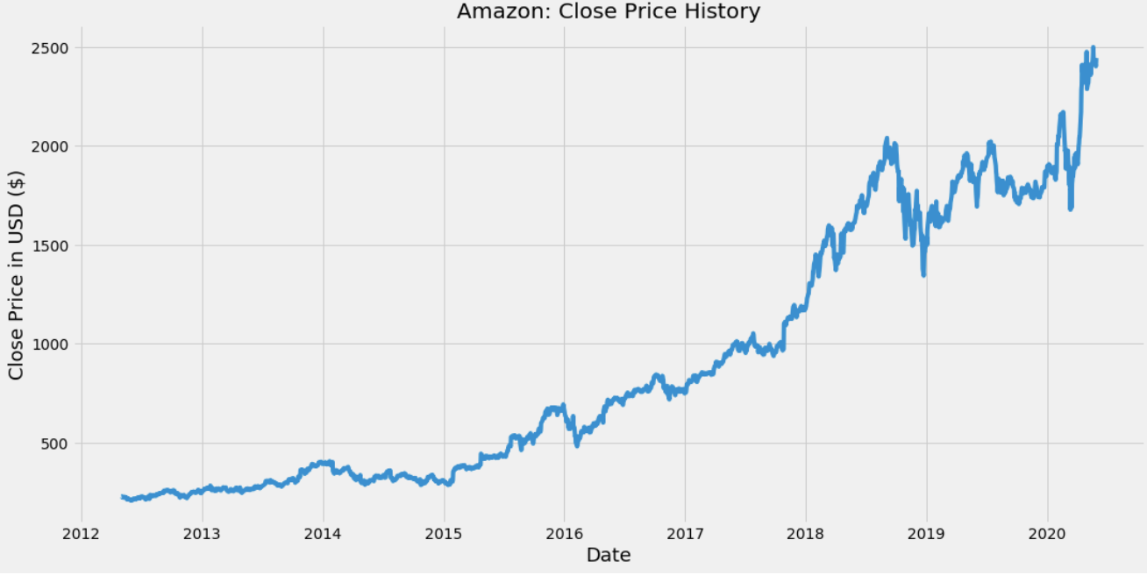
Amazon close price history

Slide 17
PREDICTIVE MODELING
A TOTAL OF TWO MODELS WERE CREATED USING AMAZON STOCK DATA
LONG SHORT-TERM MEMORY (LSTM)
AUTO-REGRESSIVE INTEGRATED MOVING AVERAGE (ARIMA)

Slide 18
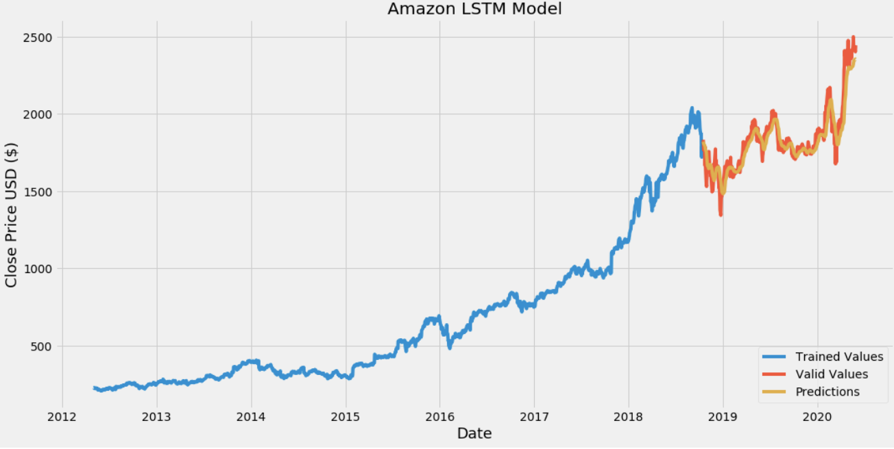
LSTM
LONG SHORT-TERM MEMORY (LSTM)
-CREATES ARTIFICAL RECURRENT NEURAL NETWORK (RNN)
- ATTEMPTS TO MODEL TIME OR SEQUENCE- DEPENDENT BEHAVIOR

Slide 19
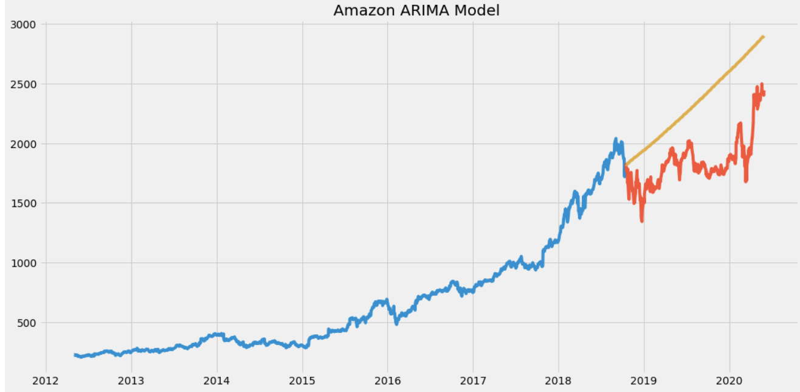
ARIMA
AUTO-REGRESSIVE INTEGRATED MOVING AVERAGE (ARIMA)
- UTILIZED FOR TIME-SERIES DATA
- USED TO BETTER UNDERSTAND DATA SET AND PREDICT FUTURE TRENDS

Slide 20
AMAZON MODEL EVALUATIONs
ROOT MEAN SQUARE ERROR (RMSE) & VISUALS WERE USED TO EVALUTE BOTH MODELS
CLOSEST PREDICTED VALUES TO ACTUAL VALUES REPRESENT THE BEST MODEL
LOWEST RMSE= BEST PREDICTOR

Slide 21
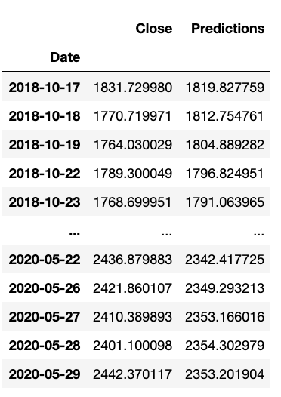
RESULTS
LONG SHORT -TERM MEMORY BEST PREDICTING MODEL
LSTM RMSE = 6.39 VERSUS ARIMA RMSE =531
PARAMETERS TUNING HELP IMPROVE ACCURACY AND ASSIST FOR FUTURE DEPLOYMENT

Slide 22
CONCLUSION
STOCK PREDICTION IS A COMPLEX TASK
AMAZON SAFE CHOICE FOR INVESTORS
COVID-19, OVERALL, HAS NOT AFFECTED RECENT STOCKS
E-COMMERCE WILL CONTINUE TO RISE
AMAZON CONTINUES TO RISE (WHOLE FOODS MARKET , AUDIBLE, ZAPPOS ETC.)

Slide 23
SOURCES CITED
Abbott., D. (2014). Applied Predictive Analytics. John Wiley & Sons, Inc.
Chen., J. (2020). Stock Market. Retrieved from https://www.investopedia.com/terms/s/stockmarket.asp
Kenton., W. (2019). S&P 500 Index – Standard & Poor's 500 Index. Retrieved from
https://www.investopedia.com/terms/s/sp500.asp
O'Shea., A. (2020). Stock Market Basics: What Beginner Investors Should Know. Retrieved from https://www.nerdwallet.com/article/investing/stock-market-basics-everything-beginner-investors-know
S&P 500 Stock Data. (2020). Retrieved from https://www.kaggle.com/alexsumt/sp-500-stock-data
S&P 500 stock data: Historical stock data for all current S&P 500 companies. (2018). Retrieved from https://www.kaggle.com/camnugent/sandp500#AAPL_data.csv
Sozzi., B. (2020). 5 powerful tech companies now make up 18% of the stock market — here's why this could be a bad thing. Retrieved from https://finance.yahoo.com/news/5-powerful-tech-companies-now-make-up-18-of-the-stock-market-heres-why-this-could-be-a-bad-thing-145710881.html

